Slide 1
Contemporary Moral Problems
M-F12:00-1:00, SAV 264
Instructor: Benjamin Hole
Office Hours: M-F,1-1:15
Email: bvhole@uw.edu

Slide 2
Agenda
Clicker Quiz
Moral Theory Primer
Finish yesterday: PFD & VE; Discuss
Ethics from Authority: Divine Command Theory
ER, next week with Rachels

Slide 3
Overview
“Six Essential”
Theories
Ethics by Authority
Consequentialism
Kantian Ethics
Natural Law Theory
Rights Based Moral Theory
Virtue Ethics
Prima Facie Duties
Divine Command Theory
Ethical Relativism

Slide 4

CLICKER QUIZ
Please set your Turning Technology Clicker to channel 41
Press “Ch”, then “41”, then “Ch”

Slide 5
1. Timmons claims that divine command theory does not plausibly address the theoretical aims of moral theory, but he allows that divine command theory might:
still be an internally consistent theory
still satisfy the principle of explanatory power
help religious believers decide what to do
all the above

Slide 6
2. Suppose Bob claims that infanticide is not wrong in certain cultures just because killing infants is permitted in those cultures. With this claim, we can reasonably infer that Bob accepts some version of:
Kantian Ethics
Natural Law Theory
Ethical Relativism
Divine Command Theory
All the above
None of the above

Slide 7
3. Timmons raises doubts about ethical relativism by asking us to consider whether:
it is compatible with Bentham’s hedonism
Kant would have endorsed a form of ethical relativism
Ross would have endorsed ethical relativism
divine command theory and ethical relativism are compatible
ethical relativism is self-contradictory
All the above
None of the above

Slide 8
Overview
“Six Essential”
Theories
Ethics by Authority
Consequentialism
Kantian Ethics
Natural Law Theory
Rights Based Moral Theory
Virtue Ethics
Prima Facie Duties
Divine Command Theory
Ethical Relativism

Slide 9
Prima Facie Duties
Confusing Term
“A prima facie duty isn’t really a duty, but a rather permanent, very strong reason to do something”*
*Russ Shafer Landau’s gloss from:
The Fundamentals of Ethics, 223.
PFDs
Fidelity
Reparations
Gratitude
Justice
Beneficence
Self-Improvement
Non-Maleficence

Slide 10
Virtue Ethics
“An action is right if and only if (and because) it is what a virtuous agent (acting in character) would not avoid doing in the circumstances under consideration.”

Slide 11
Overview
“Six Essential”
Theories
Ethics by Authority
Consequentialism
Kantian Ethics
Natural Law Theory
Rights Based Moral Theory
Virtue Ethics
Prima Facie Duties
Divine Command Theory
Ethical Relativism

Slide 12
Evaluating a Theory
Explanatory Power
Practical Guidance
“A moral theory should feature principles that explain our more specific considered moral beliefs, this helping us understand why certain actions, persons, and other objects of moral evaluation are right or wrong, good or bad. The better a theory’s principles in providing such explanations, the better the theory.” (29)
“A moral theory should feature principles that are useful in guiding moral deliberation toward correct or justified moral verdicts about particular issues which we can then use to help guide choice. The better a theory’s principles are in providing practical guidance, the better the theory.” (29)

Slide 13
Which ethical theory has the most explanatory power?
Consequentialism
Kantian Ethics
Natural Law Theory
Rights-Based Theory
Virtue Ethical Theory
Prima Facie Duties
Divine Command Theory
Ethical Relativism

Slide 14
Which ethical theory has the most practical guidance?
Consequentialism
Kantian Ethics
Natural Law Theory
Rights-Based Theory
Virtue Ethical Theory
Prima Facie Duties
Divine Command Theory
Ethical Relativism

Slide 15
Divine Command Theory
Euthyphro Dilemma

Slide 16

“DCT An act is right if and only if (and because) God does not command that we do not do the action” (Timmons, 31).

Slide 17

“If there is no God, then all is permitted.”
Or if there is no divine punishment, what reason do we have to be ethical?
Notes:
This isn’t strictly speaking about divine command theory, but about whether God is necessary for ethics.

Slide 18
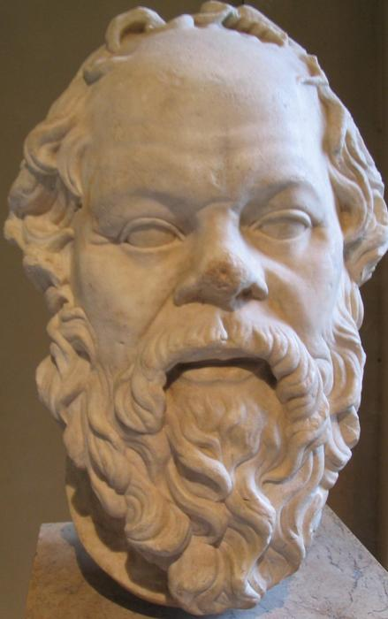
EUTHYPHRO DILEMMA:
Is it a good/right thing because God commands it, or does God command it because it is a good/right thing?

Slide 19
Horned Dilemma Argument
If A, then B or C.
B is absurd
C is absurd
Therefore, A is absurd

Slide 20
Dilemma Horn One:
If it is a good thing because God loves it:
Then is there no reason for God to love it?
Isn’t it capricious, or random? What if God commanded the torture of all left-handers?
If it is right because God commands it, then there is no basis for the word of God.

Slide 21
Dilemma Horn Two:
If God loves it because it is a good thing:
Then isn’t God constrained by some moral order, so that we might look directly at that order?
If God commands it because it is right, then there is some standard for rightness besides the word of God.

Slide 22
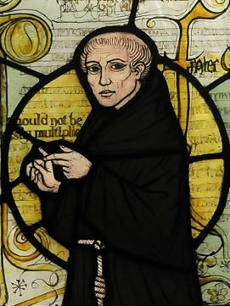
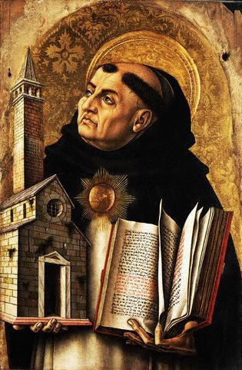
Different thinkers have answered differently…
William of Ockham:
God could indeed make murder mandatory.
St. Thomas Aquinas:
God has a reason for what he says, and this reason constrains Him.

Slide 23
The Euthyphro Dilemma
Divine Command Theory: An act is right iff (and because) God commands it.
The Dilemma: Either it right because God commands it or God command it because it is right.
Horn One: If it is right because God commands it, then there is no basis for the word of God.
Horn Two: If God commands it because it is right, then there is some standard for rightness besides the word of God.

Slide 24
Discussion Questions
Which option is better?
If it is right because God commands it, then there is no basis for the word of God.
If God commands it because it is right, then there is some standard for rightness besides the word of God.
Is there a way out of the Euthyphro dilemma?

Slide 25
Which option is better?
If it is right because God commands it, then there is no basis for the word of God.
If God commands it because it is right, then there is some standard for rightness besides the word of God.

Slide 26
DCT can avoid the Euthyphro dilemma.
True
False

Slide 27
Ethical Relativism
(ER) “An act (performed by members of group G) is right if and only if the moral norms that are accepted by G permit the performance of the action.”
(Timmons, 32)

Slide 28
ER
True
False

